Slide 1
FUNDAMENTAL PROGRAMMING TECHNIQUES
ASSIGNMENT 1 – SUPPORT PRESENTATION

Slide 2
Outline
Software development process in the context of Assignment 1
Problem and Solution
Objectives
Analysis
Design
Unit Testing with Junit
Theoretical Background
Basics of polynomial arithmetic
Graphical User Interfaces Development using Swing
Regular expressions and pattern matching

Slide 3
Software Development Process

Slide 4

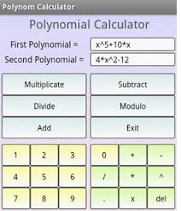
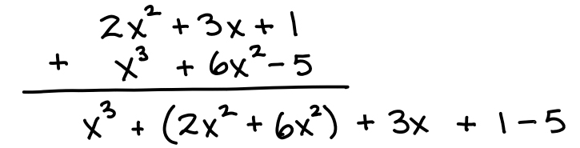
Problem and solution
PROBLEM: “Performing polynomial operations on paper is difficult and time consuming.”
SOLUTION: Polynomial calculator
How to design and implement the solution?
1. Clearly state the main objective and the sub-objectives required to reach it.
2. Analyze the problem and define the functional and non-functional requirements.
3. Design the solution
4. Implement the solution
5. Test the solution

Slide 5
Objectives
Main objective
Design and implement a polynomial calculator with a dedicated graphical interface through which the user can insert polynomials, select the mathematical operation to be performed and view the result.
Sub-objectives
Analyze the problem and identify requirements
Design the polynomial calculator
Implement the polynomial calculator
Test the polynomial calculator

Slide 6
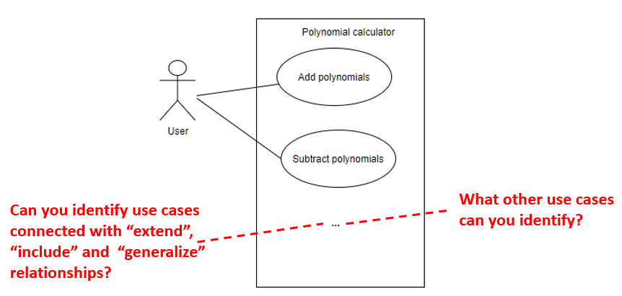
Analysis
Use Case: add polynomials
Primary Actor: user
Main Success Scenario:
The user inserts the 2 polynomials in the graphical user interface.
The user selects the “addition” operation
The user clicks on the “compute” button
The polynomial calculator performs the addition of the two polynomials and displays the result
Alternative Sequence: Incorrect polynomials
The user inserts incorrect polynomials (e.g. with 2 or more variables)
The scenario returns to step 1
Define requirements
Functional requirements:
The polynomial calculator should allow users to insert polynomials
The polynomial calculator should allow users to select the mathematical operation
The polynomial calculator should add two polynomials
… what other functional requirements can you define? …
Non-Functional requirements:
The polynomial calculator should be intuitive and easy to use by the user
… what other non-functional requirements can you define? …

Slide 7
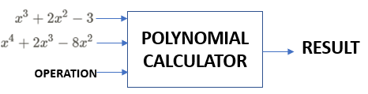
Design Level 1: Overall system design

Slide 8
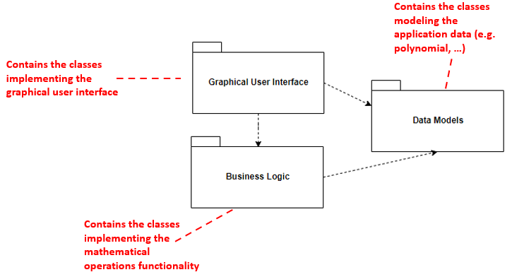
Design Level 2: Division into sub-systems/packages
GOOD PRACTICE - Use architectural patterns
Architectural patterns define structures for software systems in terms of predefined subsystems and their responsibilities. Structural patterns (e.g. Layers) and interactive systems patterns (e.g. Model View Controller) are some examples of architectural patterns types.

Slide 9
Design Level 2: Division into sub-systems/packages
Model View Controller Architectural Pattern [Ref]
Context
Many software systems deal with finding data from a repository and displaying the data to the users through a graphical user interface (GUI)
Users can modify the data and the modifications are saved back in the repository
Continuous information flow between the GUI and the repository => might be tempted to implement everything in the same class
Disadvantages:
The GUI changes more often than the business logic implementation -> if they are implemented in the same class then each time the GUI changes the business logic is changed
The business logic can not be reused
The code is complex and difficult to maintain
Solution
Use the Model View Controller pattern which divides the application into three areas: processing, output and input
Model components – encapsulate core data and functionality
View components – display information to the user - obtains the data it displays from the model
Controller – Each view has an associated controller component. Controllers receive input, usually as events that denote mouse movement, activation of mouse buttons or keyboard input. Events are translated to service requests, which are sent either to the model or to the view.

Slide 10
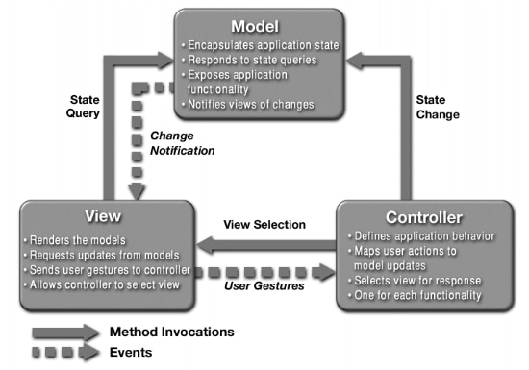
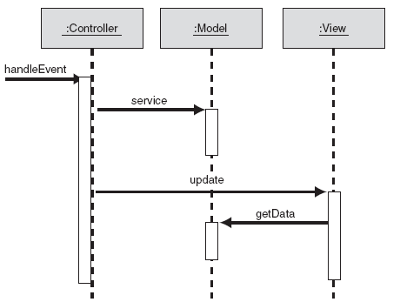
Design Level 2: Division into sub-systems/packages
Model View Controller Architectural Pattern
Source link
Check this link for an example of applying the Model View Controller Pattern

Slide 11
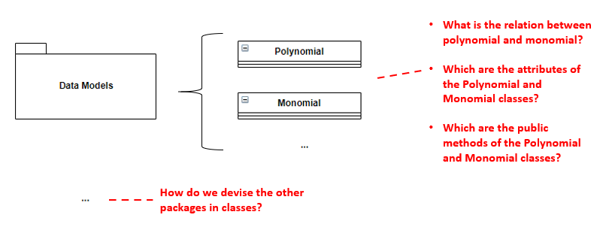

Design Level 3: Division into classes
When defining the classes think about ABSTRACTION, INHERITANCE, and ENCAPSULATION

Slide 12
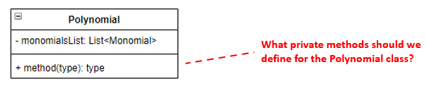
Design Level 4: Division into routines (i.e. methods)

Slide 13
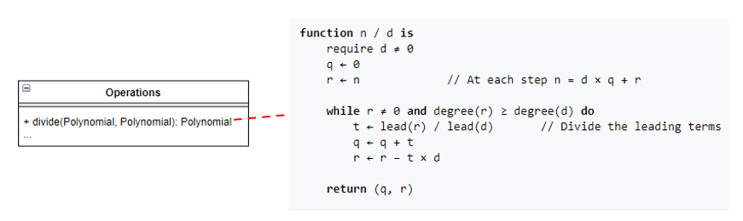
Design Level 5: Internal routine design
Implementation…

Slide 14
Unit Testing with JUnit
Software testing
The process of executing a piece of software to identify any gaps, errors, or missing requirements in contrary to the actual requirements
Software test
Piece of software which validates whether the execution of another piece of software
Results in the expected state (state testing) – result validation
Is done according to the expected sequence of events (behavior testing)
Types of testing
Unit testing – targets small units of code
Integration testing
Testing frameworks for Java
Junit, TestNG
Source link

Slide 15
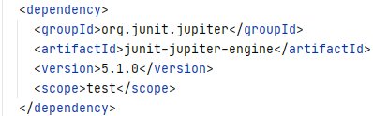
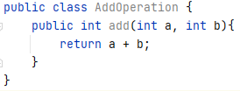
Unit Testing with JUnit
Configure Maven to work with Junit – add the Junit dependency in pom.xml
Consider the class AddOperation that defines a single method for adding two numbers

Slide 16
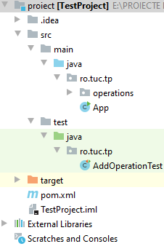
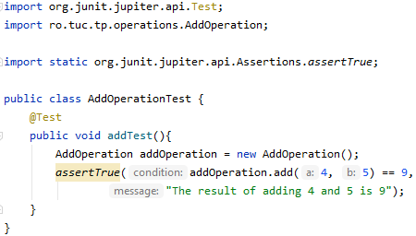
Unit Testing with JUnit
Create the test class
Create a java test class named AddOperationTest.java and place it in src/main/test
Implement a test method named addTest in your test class
Specify the annotation @Test to the method addTest()
Implement the test condition and check the condition using assertEquals API of JUnit

Slide 17
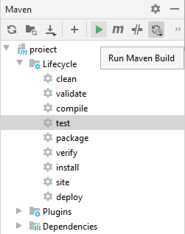
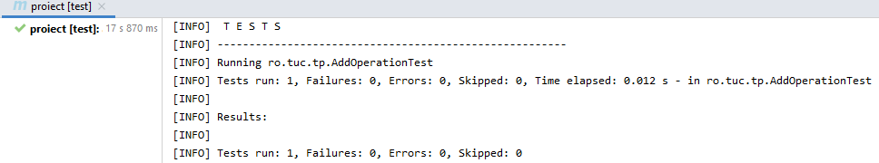
Unit Testing with JUnit
Run the test

Slide 18
Unit Testing with JUnit
Basic Annotations (Link)
Annotation | Description
@Test | Denotes that a method is a test method.
@ParameterizedTest | Denotes that a method is a parameterized test.
@RepeatedTest | Denotes that a method is a test template for a repeated test.
@BeforeEach | Denotes that the annotated method should be executed before each @Test, @RepeatedTest, @ParameterizedTest, method in the current class.
@AfterEach | Denotes that the annotated method should be executed after each @Test, @RepeatedTest, @ParameterizedTest method in the current class.
@BeforeAll | Denotes that the annotated method should be executed before all @Test, @RepeatedTest, @ParameterizedTest methods in the current class;
@AfterAll | Denotes that the annotated method should be executed after all @Test, @RepeatedTest, @ParameterizedTest, and @TestFactory methods in the current class.
… | …

Slide 19


Unit Testing with JUnit
Assertions are static methods defined in the org.junit.jupiter.api.Assertions class: assertEquals, assertAll, assertNotEquals, assertTrue, etc. - check (Link) for more examples
In case the assertion facilities provided by JUnit Jupiter are not sufficient enough, third party libraries can be used (e.g. AssertJ, Hamcrest, etc.)
Test suites – aggregate multiple test classes in a suite so that they can be run together
Note: in order to run test suites add dependencies for junit-platform-runner, junit-4.13, junit-jupiter-api and junit-jupiter-engine

Slide 20
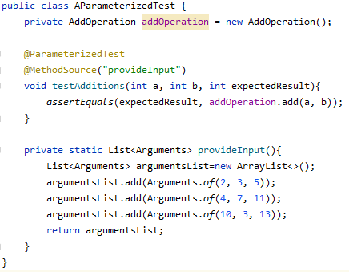
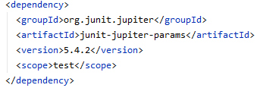
Unit Testing with JUnit
Parameterized Tests [Link] - make it possible to run a test multiple times with different arguments
Must declare at least one source that will provide the arguments for each invocation and then consume the arguments in the test method
Note:
Add the following dependency
The method providing the arguments must be static

Slide 21
Theoretical Background

Slide 22
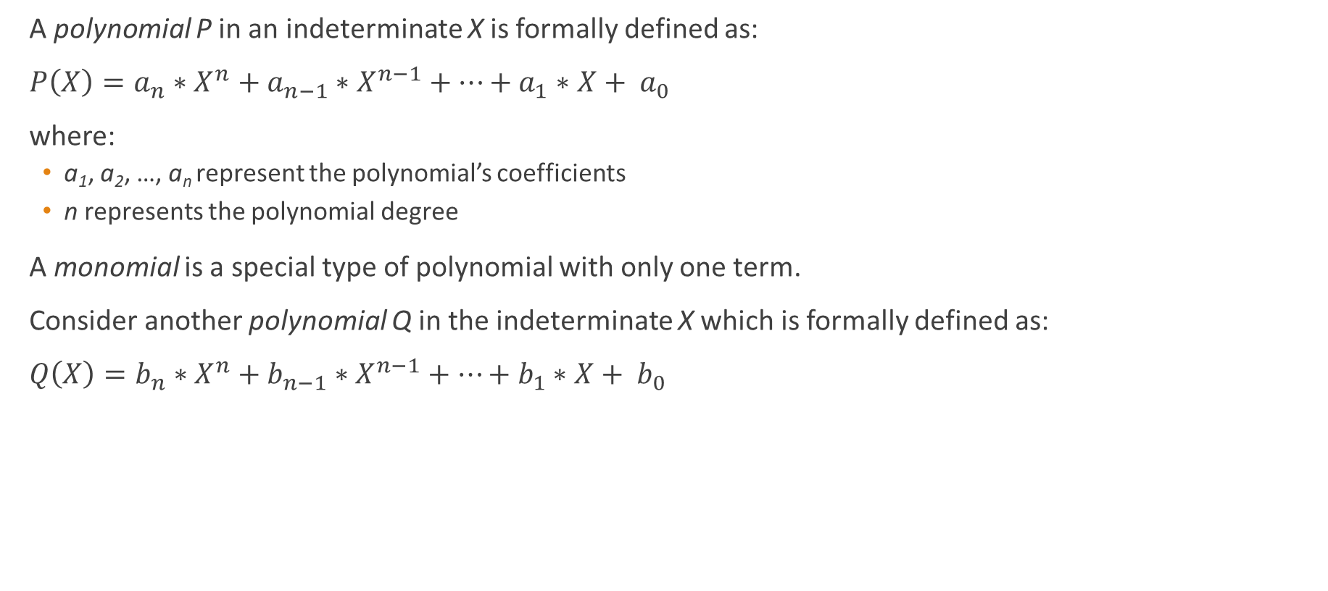
Basics of polynomial arithmetic
A polynomial P in an indeterminate X is formally defined as:
$P\left(X\right)=a_{n}∗X^{n}+a_{n−1}∗X^{n−1}+…+a_{1}∗X+ a_{0}$
where:
a₁, a₂, …, a_{n} represent the polynomial’s coefficients
n represents the polynomial degree
A monomial is a special type of polynomial with only one term.
Consider another polynomial Q in the indeterminate X which is formally defined as:
$Q\left(X\right)=b_{n}∗X^{n}+b_{n−1}∗X^{n−1}+…+b_{1}∗X+ b_{0}$

Slide 23
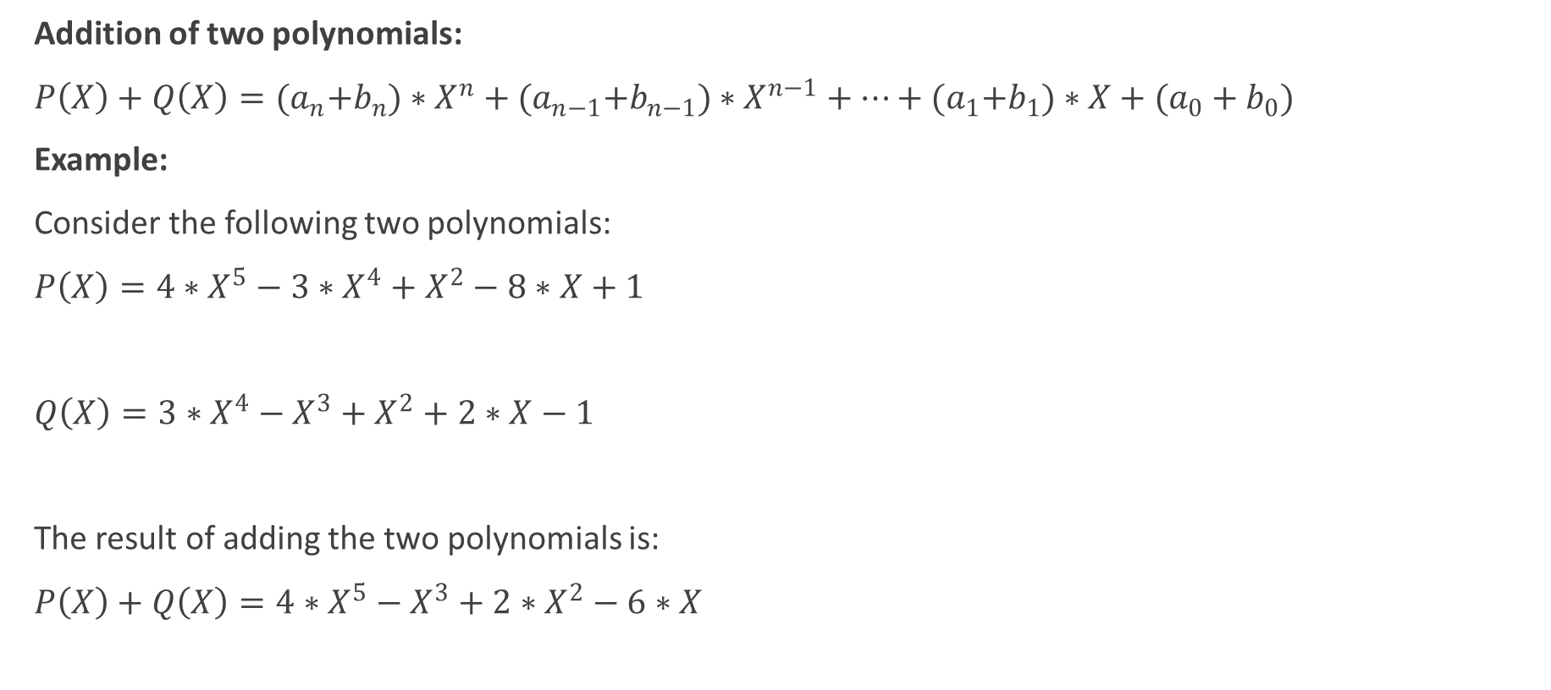
Basics of polynomial arithmetic
Addition of two polynomials:
$P\left(X\right)+Q\left(X\right)={(a}_{n}+b_{n})∗X^{n}+{(a}_{n−1}+b_{n−1})∗X^{n−1}+…+{(a}_{1}+b_{1})∗X+(a_{0}+b_{0})$
Example:
Consider the following two polynomials:
$P\left(X\right)=4∗X^{5}−3∗X^{4}+X^{2}−8∗X+1$
$Q\left(X\right)=3∗X^{4}−X^{3}+X^{2}+2∗X−1$
The result of adding the two polynomials is:
$P\left(X\right)+Q\left(X\right)=4∗X^{5}−X^{3}+2∗X^{2}−6∗X$

Slide 24
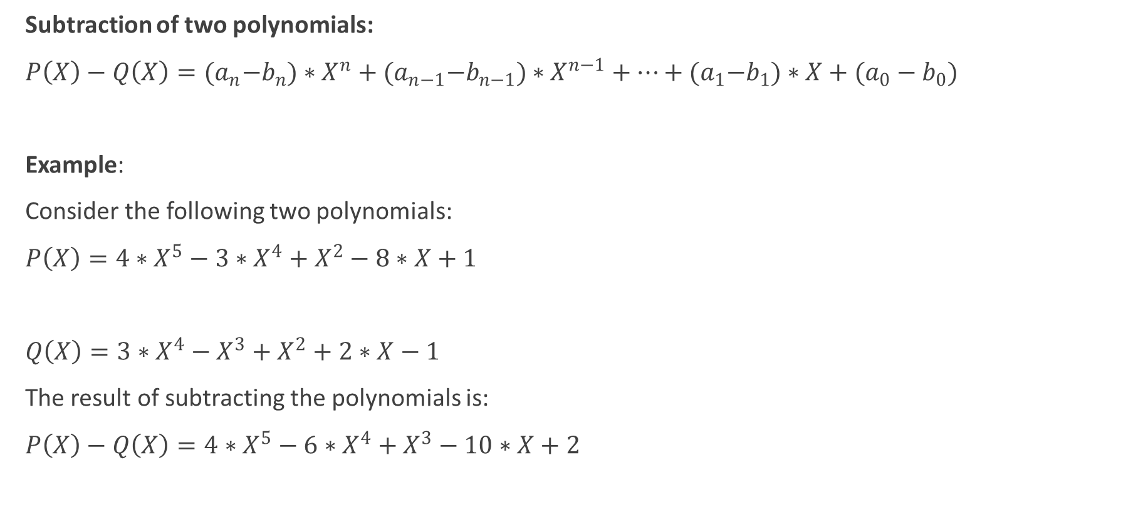
Basics of polynomial arithmetic
Subtraction of two polynomials:
$P\left(X\right)−Q\left(X\right)={(a}_{n}−b_{n})∗X^{n}+{(a}_{n−1}−b_{n−1})∗X^{n−1}+…+{(a}_{1}−b_{1})∗X+(a_{0}−b_{0})$
Example:
Consider the following two polynomials:
$P\left(X\right)=4∗X^{5}−3∗X^{4}+X^{2}−8∗X+1$
$Q\left(X\right)=3∗X^{4}−X^{3}+X^{2}+2∗X−1$
The result of subtracting the polynomials is:
$P\left(X\right)−Q\left(X\right)=4∗X^{5}−6∗X^{4}+X^{3}−10∗X+2$

Slide 25
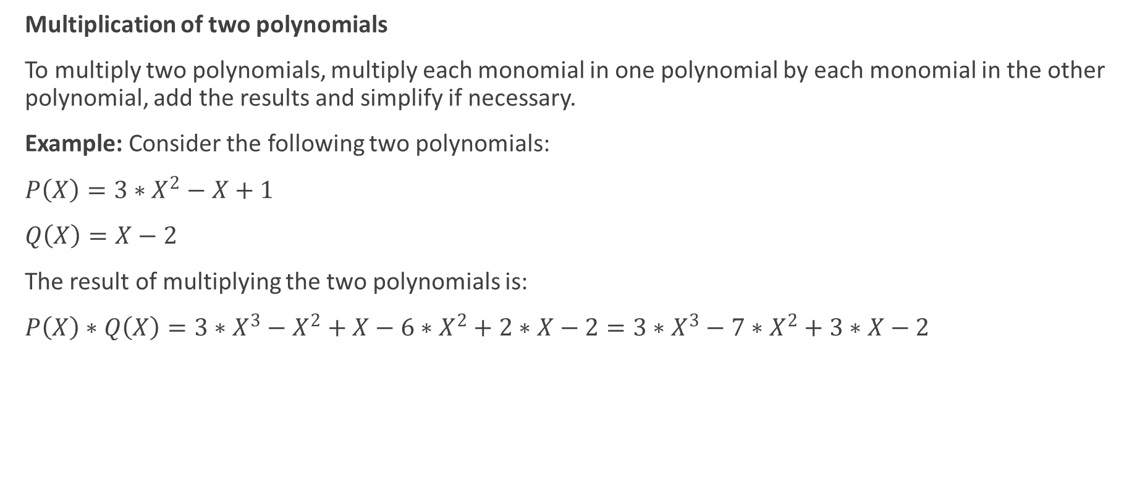
Basics of polynomial arithmetic
Multiplication of two polynomials
To multiply two polynomials, multiply each monomial in one polynomial by each monomial in the other polynomial, add the results and simplify if necessary.
Example: Consider the following two polynomials:
$P\left(X\right)=3∗X^{2}−X+1$
$Q\left(X\right)=X−2$
The result of multiplying the two polynomials is:
$P\left(X\right)∗Q\left(X\right)=3∗X^{3}−X^{2}+X−6∗X^{2}+2∗X−2=3∗X^{3}−7∗X^{2}+3∗X−2$

Slide 26
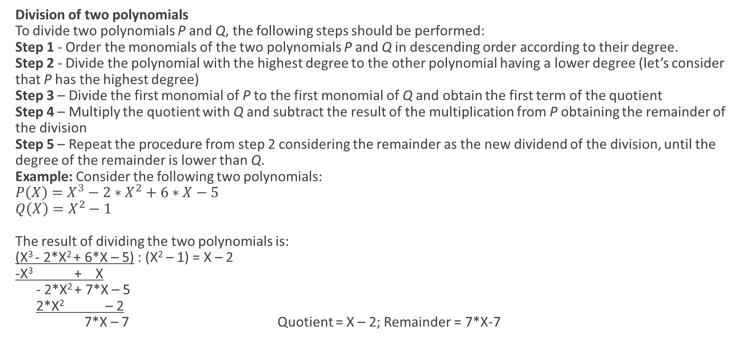
Basics of polynomial arithmetic
Division of two polynomials
To divide two polynomials P and Q, the following steps should be performed:
Step 1 - Order the monomials of the two polynomials P and Q in descending order according to their degree.
Step 2 - Divide the polynomial with the highest degree to the other polynomial having a lower degree (let’s consider that P has the highest degree)
Step 3 – Divide the first monomial of P to the first monomial of Q and obtain the first term of the quotient
Step 4 – Multiply the quotient with Q and subtract the result of the multiplication from P obtaining the remainder of the division
Step 5 – Repeat the procedure from step 2 considering the remainder as the new dividend of the division, until the degree of the remainder is lower than Q.
Example: Consider the following two polynomials:
$P\left(X\right)=X^{3}−2∗X^{2}+6∗X−5$
$Q\left(X\right)=X^{2}−1$
The result of dividing the two polynomials is:
(X³ - 2*X² + 6*X – 5) : (X² – 1) = X – 2
-X³ + X
- 2*X² + 7*X – 5
2*X² – 2
7*X – 7 Quotient = X – 2; Remainder = 7*X-7

Slide 27
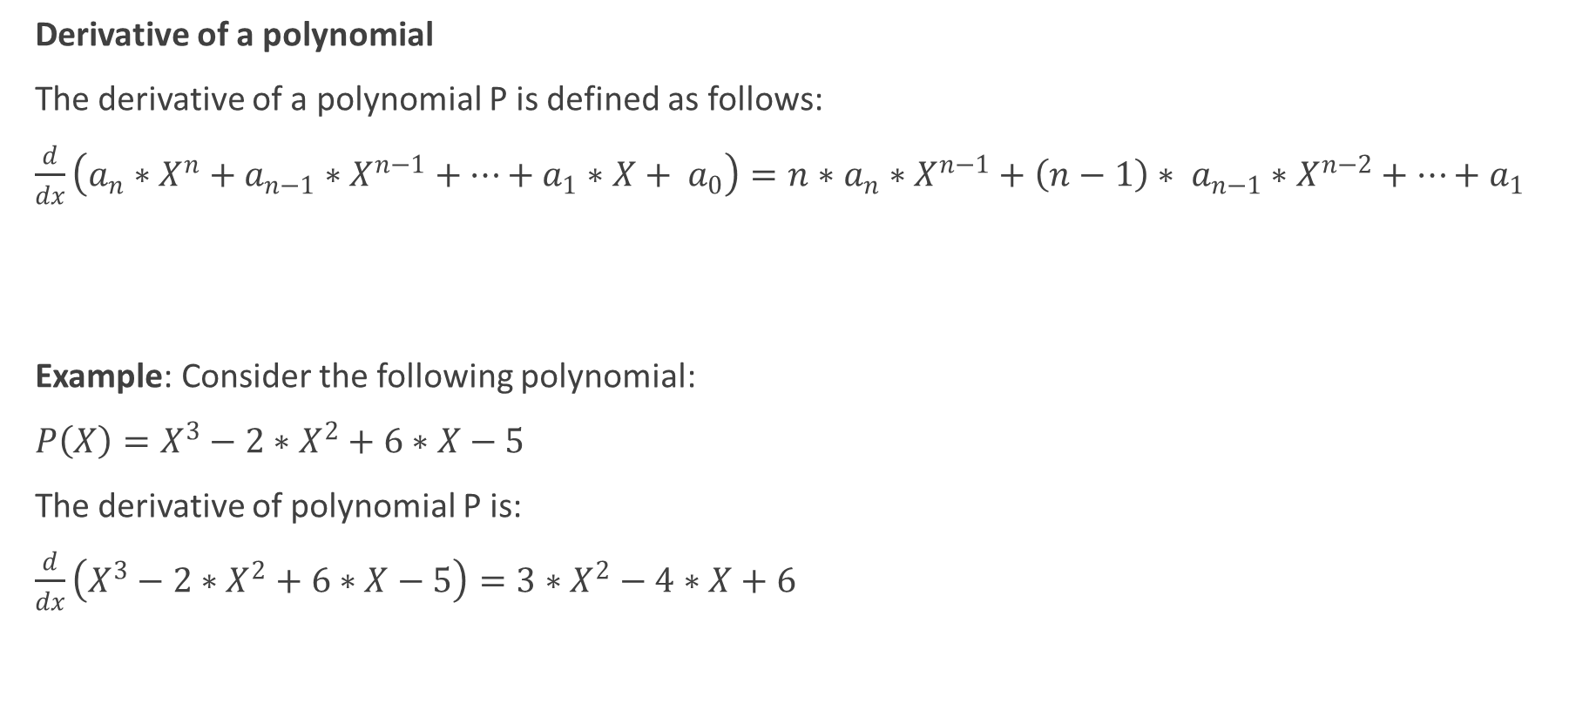
Basics of polynomial arithmetic
Derivative of a polynomial
The derivative of a polynomial P is defined as follows:
$\frac{d}{dx}\left(a_{n}∗X^{n}+a_{n−1}∗X^{n−1}+…+a_{1}∗X+ a_{0}\right)=n∗a_{n}∗X^{n−1}+{\left(n−1\right)∗ a}_{n−1}∗X^{n−2}+…+a_{1}$
Example: Consider the following polynomial:
$P\left(X\right)=X^{3}−2∗X^{2}+6∗X−5$
The derivative of polynomial P is:
$\frac{d}{dx}\left(X^{3}−2∗X^{2}+6∗X−5\right)=3∗X^{2}−4∗X+6$

Slide 28
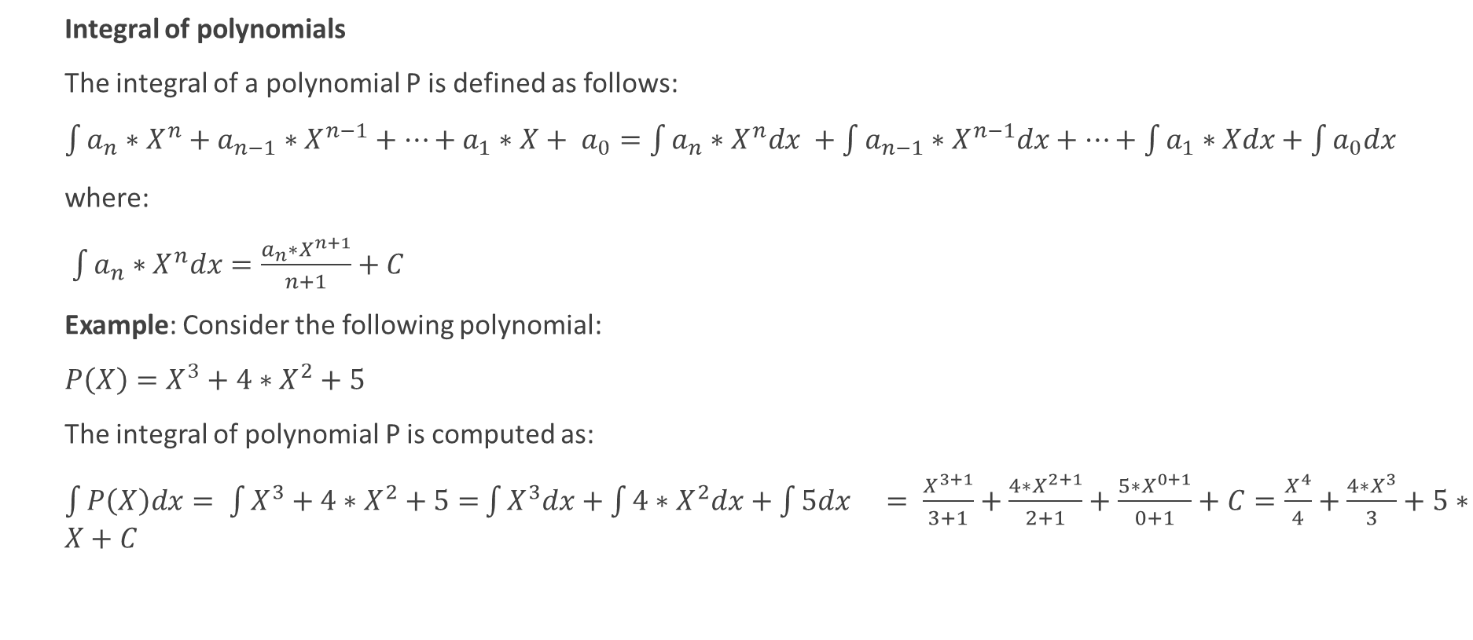
Basics of polynomial arithmetic
Integral of polynomials
The integral of a polynomial P is defined as follows:
$\int{a_{n}∗X^{n}+a_{n−1}∗X^{n−1}+…+a_{1}∗X+ a_{0}=\int{a_{n}∗X^{n}dx} +\int{a_{n−1}∗X^{n−1}dx}+…+\int{a_{1}∗Xdx}+\int{a_{0}dx} }$
where:
$\int{a_{n}∗X^{n}dx}=\frac{{a_{n}∗X}^{n+1}}{n+1}+C$
Example: Consider the following polynomial:
$P\left(X\right)=X^{3}+4∗X^{2}+5$
The integral of polynomial P is computed as:
$\int{P\left(X\right)dx= \int{X^{3}+4∗X^{2}+5=}}\int{X^{3}dx+\int{4∗X^{2}dx+\int{5dx = \frac{X^{3+1}}{3+1}+\frac{4∗X^{2+1}}{2+1}+\frac{5∗X^{0+1}}{0+1}+C=\frac{X^{4}}{4}}}}+\frac{4∗X^{3}}{3}+5∗X+C$
Source link

Slide 29
Graphical User Interfaces Development using Swing
SWING API [Link]
Is part of the Java Foundation Classes (JFC)
Offers facilities to write applications with a graphical user interface
Includes 17 packages consisting of classes and interfaces
javax.swing - Is the most important package from Swing
Component Type | Examples
Atomic components | JLabel, JButton, JCheckBox, JRadioButton, JToggleButton, JScrollBar, JSlider
Complex components | JTable, JTree, JComboBox, JList, JFileChooser, JColorChooser, JOptionPane
Text components | JTextField, JPasswordField, JTextArea, JEditorPane, JTextPane
Menus | JMenuBar, JMenu, JPopupMenu, JMenuItem, CheckboxMenuItem , JRadioButtonMenuItem
Intermediate containers | JPanel, JTabbedPane, JDesktopPane
Top level containers | JFrame, JDialog

Slide 30
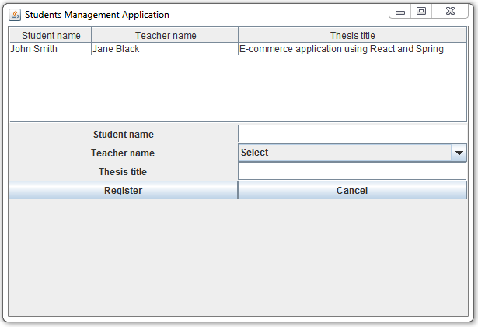
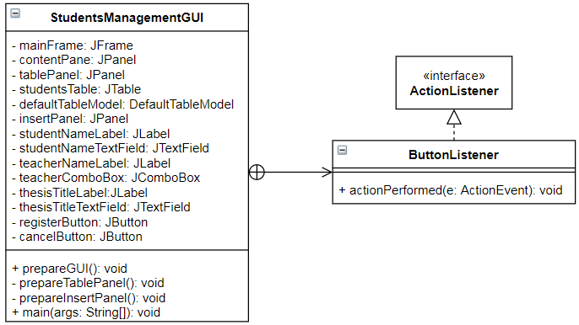
Graphical User Interfaces Development using Swing
Example – students management application
GOOD TO KNOW – TOP-LEVEL CONTAINERS [Link]
The graphical components must be included in a containment hierarchy having a top-level container (e.g. JFrame, JDialog) as root. In particular, the graphical components will be contained in the content pane of the top-level container. A menu bar can be included in a top-level container, but it will reside outside the content pane. To create and set up a frame, the following steps should be performed:
• Create the frame by instantiating the JFrame class.
• Create components and add them to the frame’s content pane.
• Size the frame manually (using the setSize method), or automatically (using the pack method).
• Show the frame onscreen (using the setVisible method).
To get the content pane of a JFrame component, the method getContentPane defined in the JFrame class is used. There are 2 approaches for setting the content pane of a JFrame component:
1) Use the method getContentPane() defined in the JFrame class to get the frame’s content pane and add various components to it: mainFrame.getContentPane().add(tablePanel);
Note: mainframe.add(tablePanel) can also be used as the add method has been overridden and it actually adds tablePanel to the frame’s content pane
2) Use the JFrame’s setContentPane method to make another component the content pane of the frame:
JPanel contentPanePanel = new JPanel();
// add other graphical components to contentPanePane
…
mainFrame.setContentPane(contentPanePanel);

Slide 31
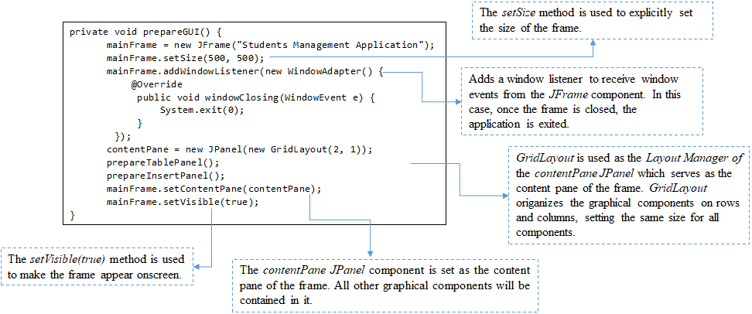
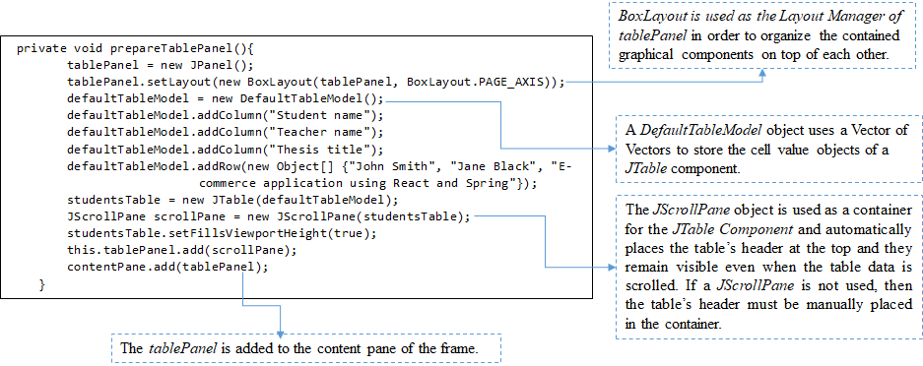
Graphical User Interfaces Development using Swing
Example – students management application

Slide 32
Graphical User Interfaces Development using Swing
Layout Managers are used to organize graphical components in containers. The following Layout Managers can be used [Link]:
a) BorderLayout – places the components in 5 areas: top, bottom, left, right, and centre.
b) BoxLayout – places the components on a row or on a column.
c) CardLayout – enables the implementation of an area that contains different components at different times.
d) FlowLayout – places the components in a single row.
e) GridBagLayout – places the components in a grid of cells, allowing the spanning and sizing of components over multiple cells.
f) GridLayout – sets equal sizes for the components and places them in the requested number of rows and columns.

Slide 33
Regular expressions and pattern matching
java.util.regex package [Ref]
Contains classes used for pattern matching with regular expressions
Regular expression = sequence of characters defining a search pattern
Result of matching a regular expression against a text
True/false result -> specifies if the regular expression matched the text
Set of matches – one match for every occurrence of the regular expression found in the text
Consists of the classes:
Class | Description
Pattern | Pattern object = compiled representation of a regular expression compile() methods - accept a regular expression as the first argument, to return a Pattern object
Matcher | Matcher object = engine that interprets the pattern and performs match operations against an input string matcher() method – invoked on a Pattern object to obtain a Matcher object Other methods Index methods (start, end) – show where the match was found in the input string Study methods (lookingAt, find, matches) – review the input string and return a Boolean indicating whether or not the pattern is found Replacement methods (appendReplacement, appendTail, replaceAll, replaceFirst, quoteReplacement) – replace text in an input string
PatternSyntaxException | PatternSyntaxException object – unchecked exception indicating syntax error in a regular expression pattern

Slide 34



Regular expressions and pattern matching
Quantifiers are used to specify the number of occurrences to match against – at first glance it may appear that they do exactly the same thing but there are subtle implementation differences between them:
Greedy quantifiers force the matcher to read in, or eat, the entire input string prior to attempting the first match. If the first match attempt (the entire input string) fails, the matcher backs off the input string by one character and tries again, repeating the process until a match is found or there are no more characters left to back off from.
Reluctant quantifiers start at the beginning of the input string, then reluctantly eat one character at a time looking for a match. The last thing they try is the entire input string.
Possessive quantifiers always eat the entire input string, trying once (and only once) for a match.
Category | Construct | Matches
Greedy quantifiers | X? | X, once or not at all
 | X* | X, zero or more times
 | X+ | X, one or more times
 | X{n} | X, exactly n times
 | X{n,} | X, at least n times
 | X{n,m} | X, at least n but not more than m times
Reluctant quantifiers | X?? | X, once or not at all
 | X*? | X, zero or more times
 | X+? | X, one or more times
 | X{n}? | X, exactly n times
 | X{n,}? | X, at least n times
 | X{n,m}? | X, at least n but not more than m times
Possessive quantifiers | X?+ | X, once or not at all
 | X*+ | X, zero or more times
 | X++ | X, one or more times
 | X{n}+ | X, exactly n times
 | X{n,}+ | X, at least n times
 | X{n,m}+ | X, at least n but not more than m times
Category | Construct | Matches
Character classes | [abc] | a, b, or c (simple class)
 | [^abc] | Any character except a, b, or c (negation)
 | [a-zA-Z] | a through z or A through Z, inclusive (range)
 | [a-d[m-p]] | a through d, or m through p: [a-dm-p] (union)
 | [a-z&&[def]] | d, e, or f (intersection)
 | [a-z&&[^bc]] | a through z, except for b and c: [ad-z] (subtraction)
 | [a-z&&[^m-p]] | a through z, and not m through p: [a-lq-z](subtraction)
Predefined character classes | . | Any character
 | \d | A digit: [0-9]
 | \D | A non-digit: [^0-9]
 | \s | A whitespace character: [ \t\n\x0B\f\r]
 | \S | A non-whitespace character: [^\s]
 | \w | A word character: [a-zA-Z_0-9]
 | \W | A non-word character: [^\w]
Logical operators | XY | X followed by Y
 | X|Y | Either X or Y
 | (X) | X, as a capturing group
Source link

Slide 35
Regular expressions and pattern matching
Example - Create a regular expression for validating Romanian mobile phone numbers. A valid mobile phone number should contain 10 digits, out of which the first 2 should be 07, and the rest from 0 to 9
…
String PHONE_PATTERN = "07[0-9]{8}";
String PHONE_EXAMPLE = "1711123456";
Pattern pattern = Pattern.compile(PHONE_PATTERN);
Matcher matcher = pattern.matcher(PHONE_EXAMPLE);
if(matcher.matches()){
System.out.println("The phone is valid");
}
else {
System.out.println("The phone is not valid");
}
…
To test your regular expressions check this link

Slide 36

Regular expressions and pattern matching
Capturing groups
Are a way to treat multiple characters as a single unit
Are created by placing the characters to be grouped inside a set of parentheses – example: (ABC)
Are numbered by counting their opening parenthesis from left to right – check the example below
The expression ((A)(B(C))) contains 4 groups
Example
Group number | Matching
1 | ((A)(B(C)))
2 | (A)
3 | (B(C))
4 | (C)
String text = "John writes about this, and John Doe writes about that," +
" and John Wayne writes about everything.“;
String patternString1 = "((John) (.+?)) ";
Pattern pattern = Pattern.compile(patternString1);
Matcher matcher = pattern.matcher(text);
while(matcher.find()) {
System.out.println("found: <" + matcher.group(1) +
"> <" + matcher.group(2) +
"> <" + matcher.group(3) + ">");
}
Sources link1 and link2

